Slide 1
NoSQL Databases (18CS823)
Presenter:
Mrs. Ancy Thomas
Assistant Professor
Department of Computer Science and Engineering
Acharya Institute of Technology

Slide 2
NoSQL Databases: Map Reduce
Module 3

Slide 3
NoSQL databases: Aggregated DBs
NoSQL data models
Key-value, document, column databases
Distribution models
Consistency
Map-Reduce
3

Slide 4
Map Reduce
When you have a cluster, you have lots of machines to spread the computation over.
However, you also still need to try to reduce the amount of data that needs to be transferred across the network.
The map-reduce pattern is a way to organize processing in such a way as to take advantage of multiple machine on a cluster while keeping as much processing and the data it needs together on the same machine.
4

Slide 5
Map Reduce
This programming model gained prominence with Google’s MapReduce framework [Dean and Ghemawat, OSDI-04].
A widely used open-source implementation is part of the Apache Hadoop project.
The name “map-reduce” reveals its inspiration from the map and reduce operations on collections in functional programming languages.
5

Slide 6
Map Reduce - benefits
Complex details are abstracted away from the developer
No file I/O
No networking code
No synchronization
It’s scalable because you process one record at a time
A record consists of a key and corresponding value
6

Slide 7
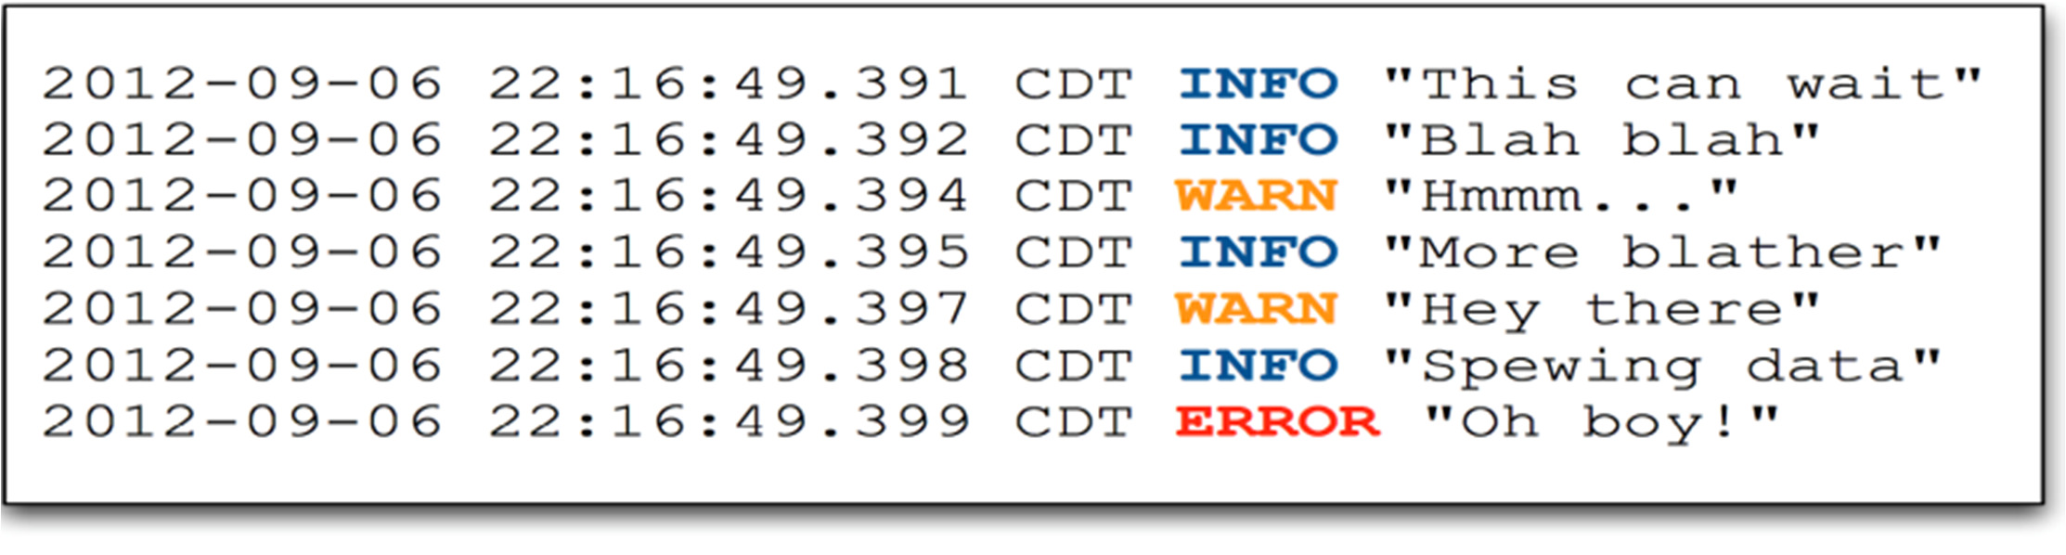
Map Reduce Example* – Job input
Each mapper gets a chunk of job’s input data to process
– This “chunk” is called an InputSplit
In this example the input is a portion of a log with a list of events, each of a certain type (INFO, WARN…)
*This example is taken from: An Introduction to Hadoop. Mark Fei (Cloudera). Strata
+ Hadoop World 2012 Conference
93

Slide 8
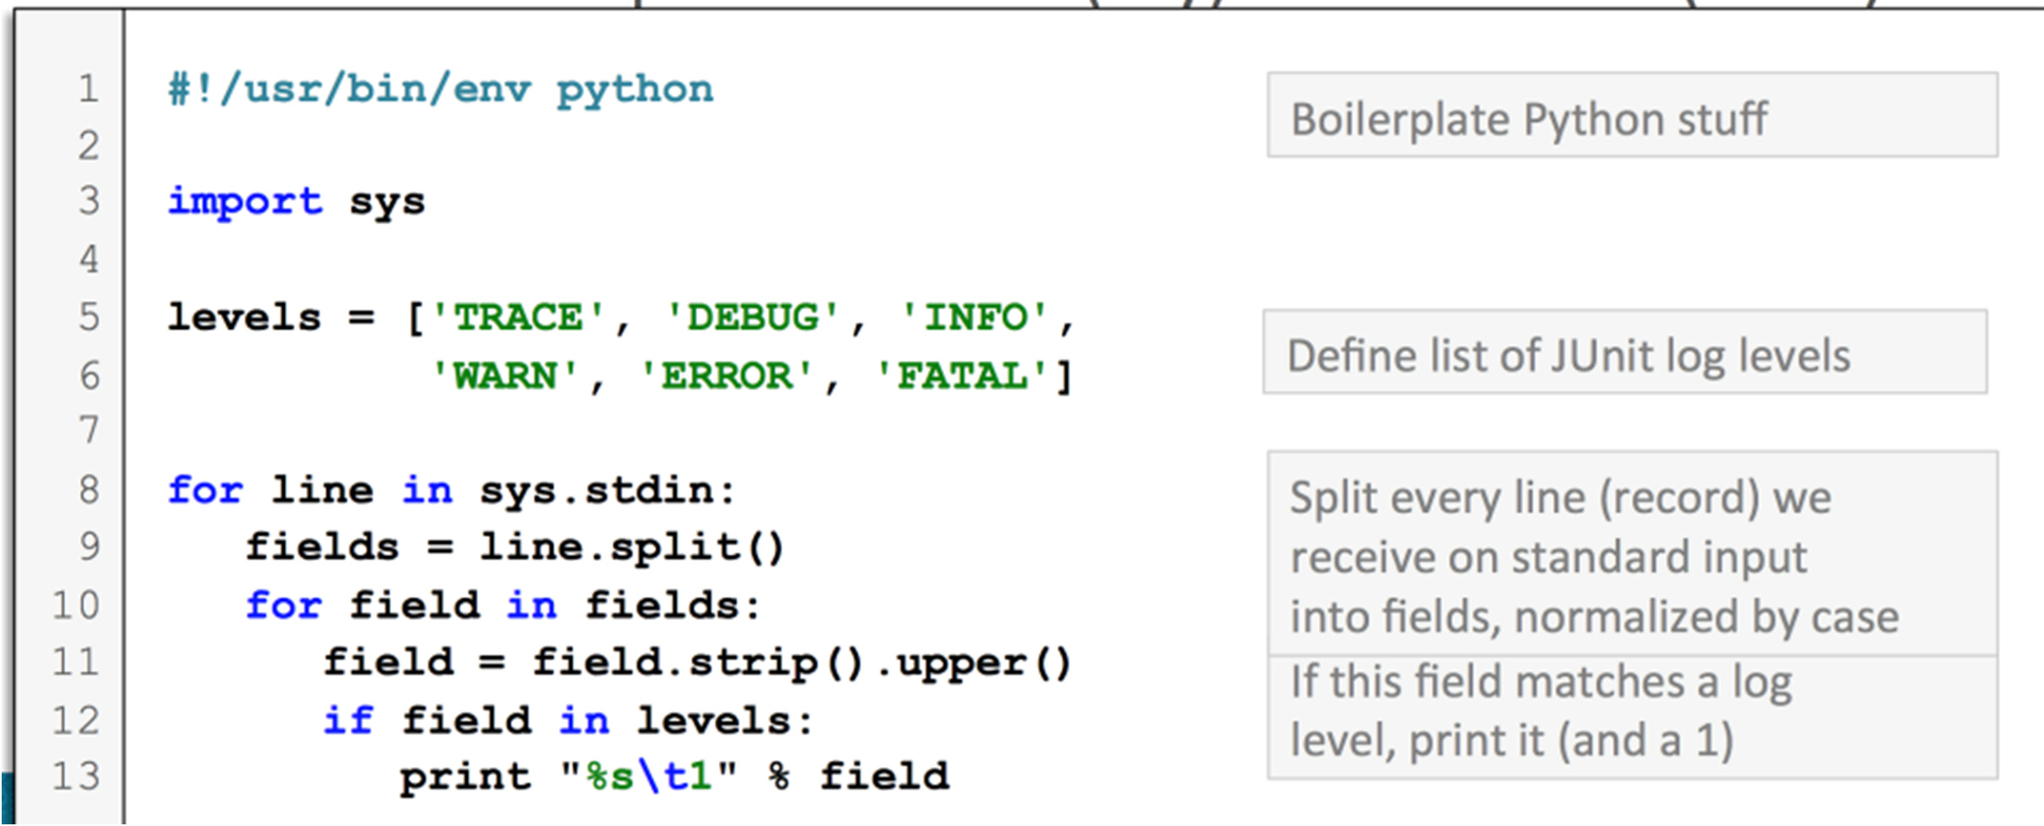
Map Reduce Example – Phyton code for map function
The map function will parse the event type, and then output that event (key) and a literal 1 (value)
8

Slide 9
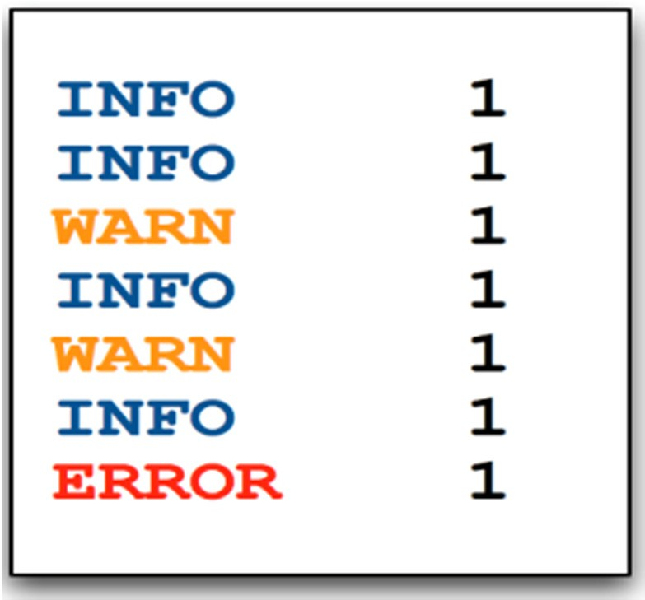
Map Reduce Example– output of map function
The map function produces key/value pairs as output
9

Slide 10
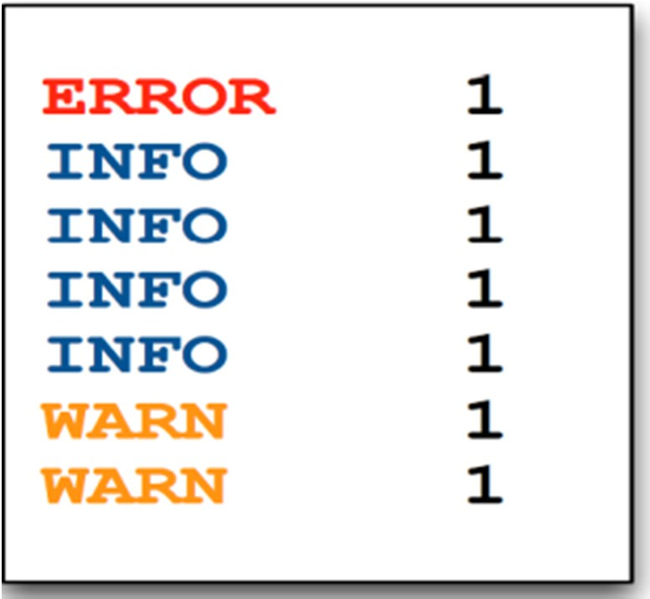
Map Reduce Example – Input to Reduce Function
The (single) Reducer receives a key and all values for that key
Keys are always passed to reducers in sorted order whereas, values are unordered
10

Slide 11
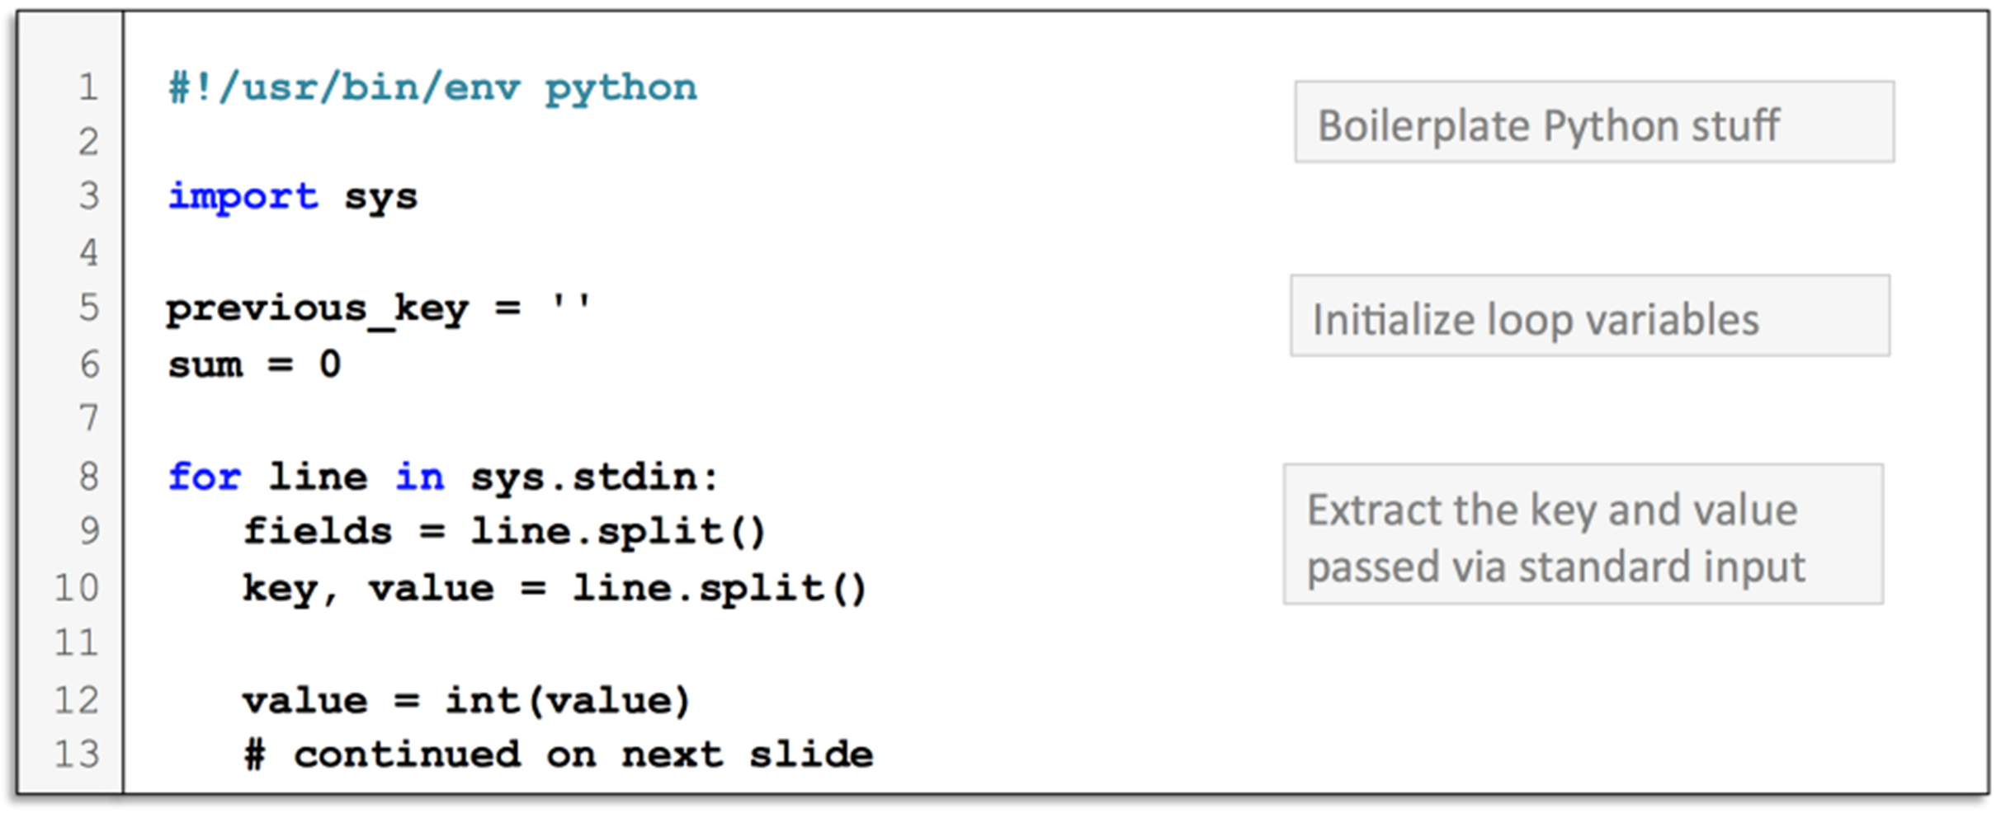
Map Reduce Example – Python Code for Reduce Function
The Reducer first extracts the key and value it was passed
11

Slide 12
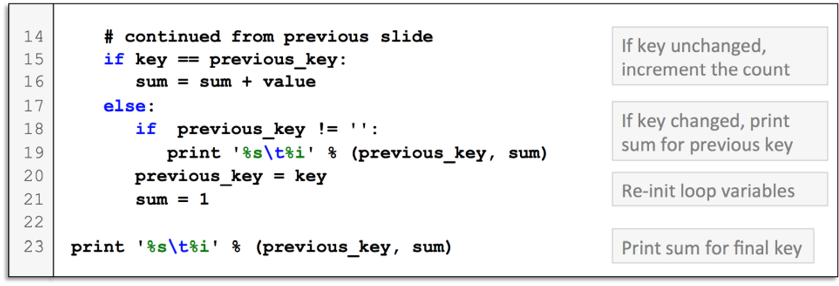
Map Reduce Example – Python Code for Reduce Function
Then simply adds up the value for each key
12

Slide 13
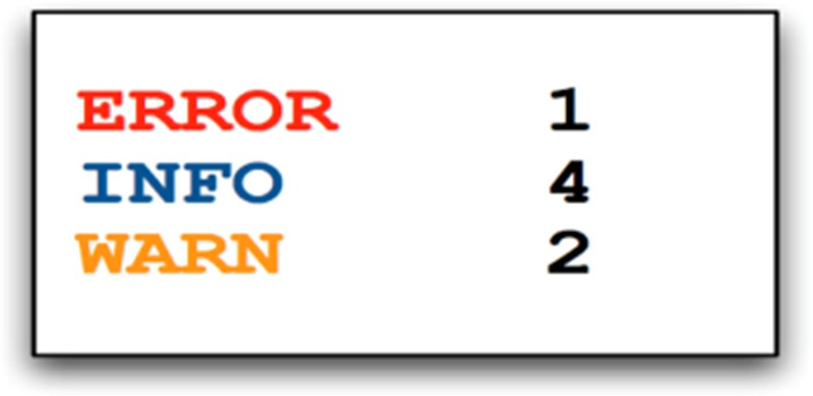
Map Reduce Example – Output of the Reduce Function
The output of this Reduce function is a sum for each level
13

Slide 14
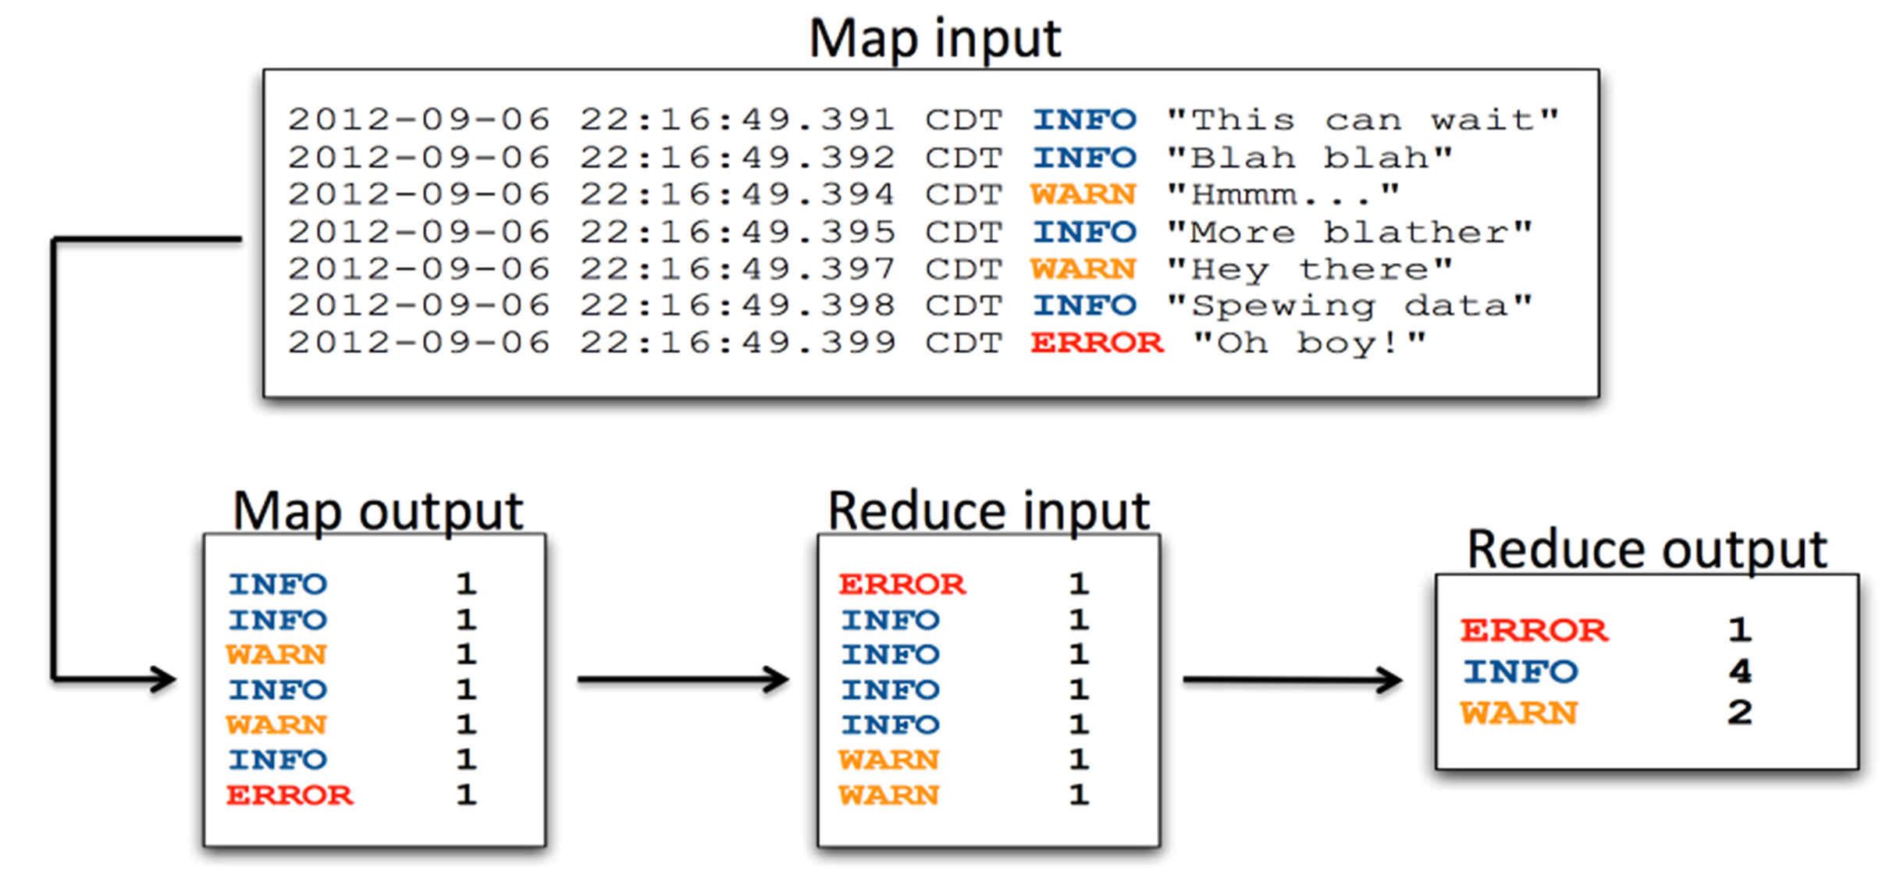
Map Reduce Example – Recap in data flow
14

Slide 15
MongoDB
In MongoDB, map-reduce is a data processing programming model that helps to perform operations on large data sets and produce aggregated results.
MongoDB provides the mapReduce() function to perform the map-reduce operations.
This function has two main functions, i.e., map function and reduce function.
The map function is used to group all the data based on the key-value and the reduce function is used to perform operations on the mapped data.
So, the data is independently mapped and reduced in different spaces and then combined together in the function and the result will save to the specified new collection.
This mapReduce() function generally operated on large data sets only.
Using Map Reduce perform aggregation operations such as max, avg on the data using some key can be performed and it is similar to groupBy in SQL. It performs on data independently and parallel.

Slide 16
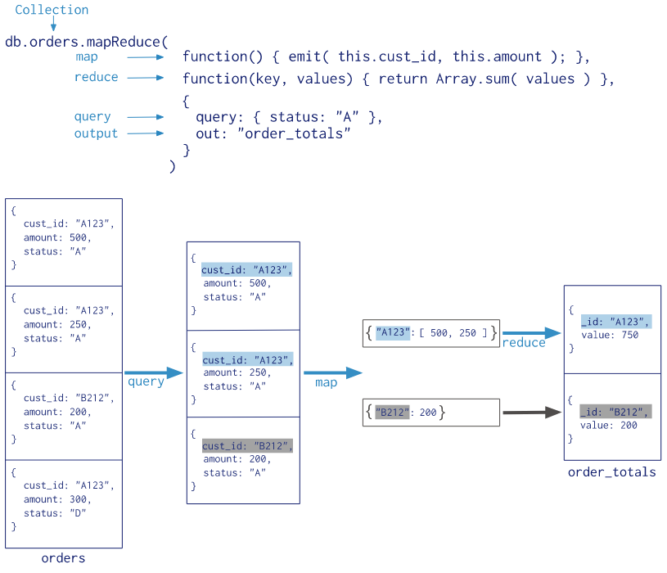
To perform map-reduce operations, MongoDB provides the mapReduce database command. Consider the following map-reduce operation:

Slide 17
All map-reduce functions in MongoDB are JavaScript and run within the mongod process.
Map-reduce operations take the documents of a single collection as the input and can perform any arbitrary sorting and limiting before beginning the map stage.
mapReduce can return the results of a map-reduce operation as a document, or may write the results to collections.

Slide 18
Example 2
we have five records from which we need to take out the maximum marks of each section and the keys are id, sec, marks.
{"id":1, "sec":A, "marks":80}
{"id":2, "sec":A, "marks":90}
{"id":1, "sec":B, "marks":99}
{"id":1, "sec":B, "marks":95}
{"id":1, "sec":C, "marks":90}

Slide 19
var map = function(){emit(this.sec, this.marks)};
After iterating over each document Emit function will give back the data like this:
{“A”:[80, 90]}, {“B”:[99, 90]}, {“C”:[90] }
A:[80, 90] = 90 (Max) B:[99, 90] = 99 (max) , C:[90] = 90(max).
var reduce = function(sec,marks){return Array.max(marks);};
db.collectionName.mapReduce(map,reduce,{out :"collectionName"});
{"id":"A", value:90}
{"id":"B", value:99}
{"id":"C", value:90}

Slide 20
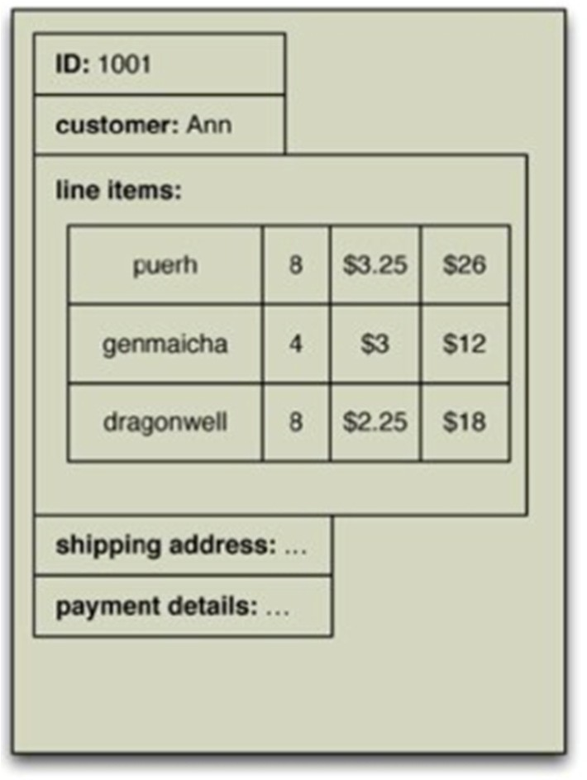
An Example with Aggregate data
Let us consider the usual scenario of customers and orders
We have chosen order as our aggregate, with each order having line items.
Each line item has a product ID, quantity, and
the price charged.
Sales analysis people want to see a product and its total revenue for the last seven days.
20

Slide 21
An Example with Aggregate data
In order to get the product revenue report, you’ll have to visit every machine in the cluster and examine many records on each machine.
This is exactly the kind of situation that calls for map-reduce. Again, the first stage in a map-reduce job is the map.
A map is a function whose input is a single aggregate and whose output is a bunch of key-value pairs.
In this case, the input would be an order, and the output would be key-value pairs corresponding to the line items
For this example, we are just selecting a value out of the record, but there’s no reason why we can’t carry out some arbitrarily complex function as part of the map—providing it only depends on one aggregate’s worth of data.
21

Slide 22
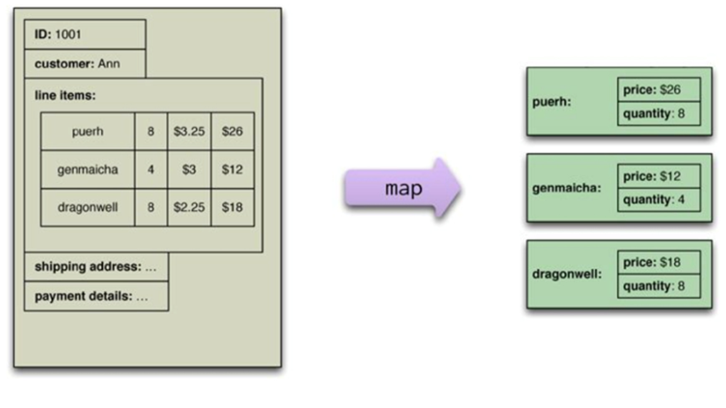
An Example with Aggregate data
Each such pair would have the product ID as the key and an embedded map with the quantity and price as the value
22

Slide 23
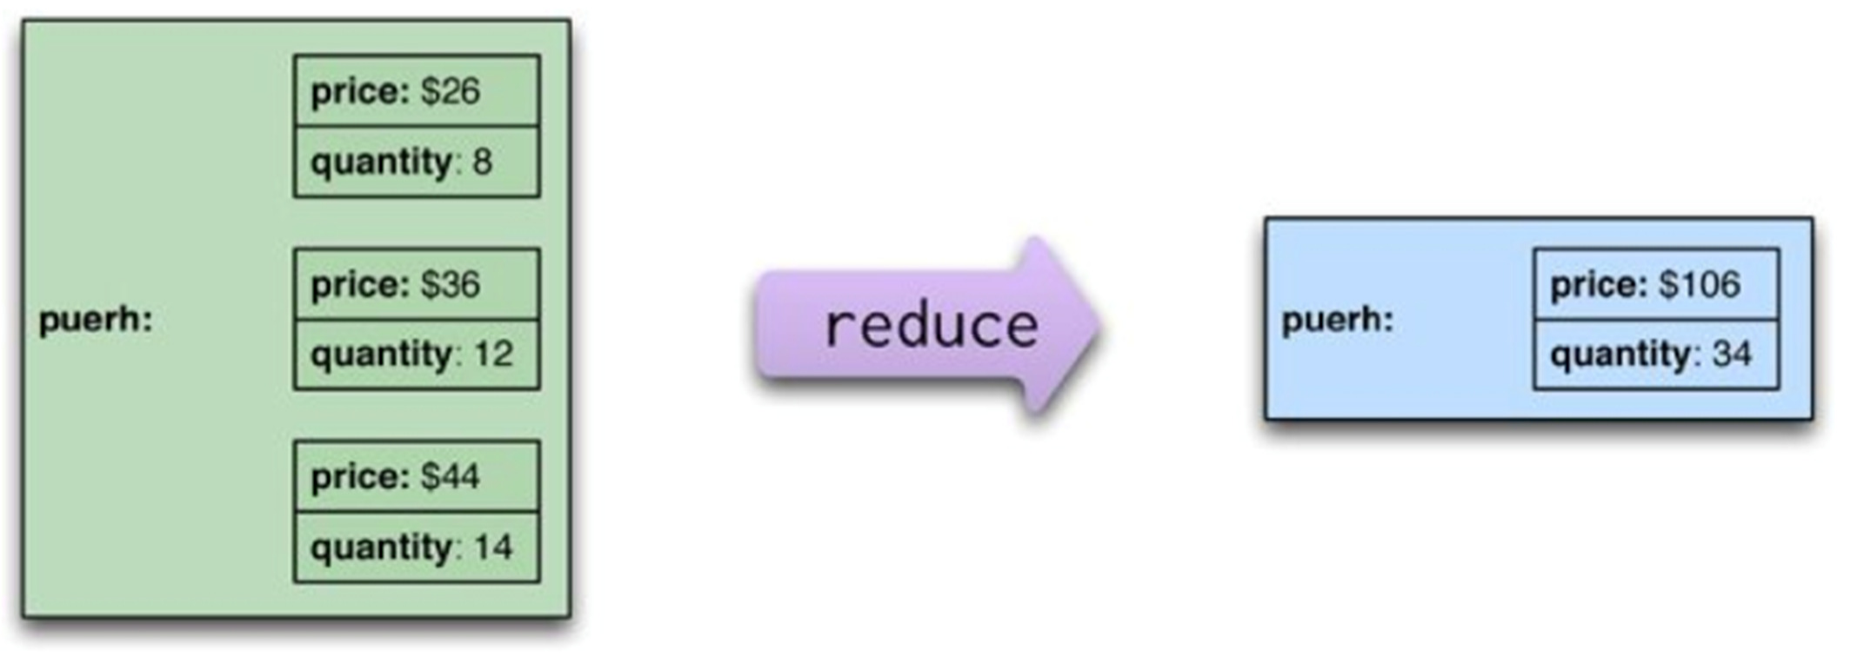
An Example with Aggregate data
The reduce function takes multiple map outputs with the same key and combines their values
23

Slide 24
An Example with Aggregate data
The map-reduce framework arranges for map tasks to be run on the correct nodes to process all the documents and for data to be moved to the reduce framework
The framework collects all the values for a single pair and calls the reduce function once with the key and the collection of all the values for that key
So to run a map-reduce job, you just need to write these two functions.
Each application of the map function is independent of all the others. This allows them to be safely parallelizable, so that a map- reduce framework can create efficient map tasks on each node and freely allocate each order to a map task.
To increase parallelism, we can also partition the output of the mappers and send each partition to a different reducer (“shuffling”)
24

Slide 25
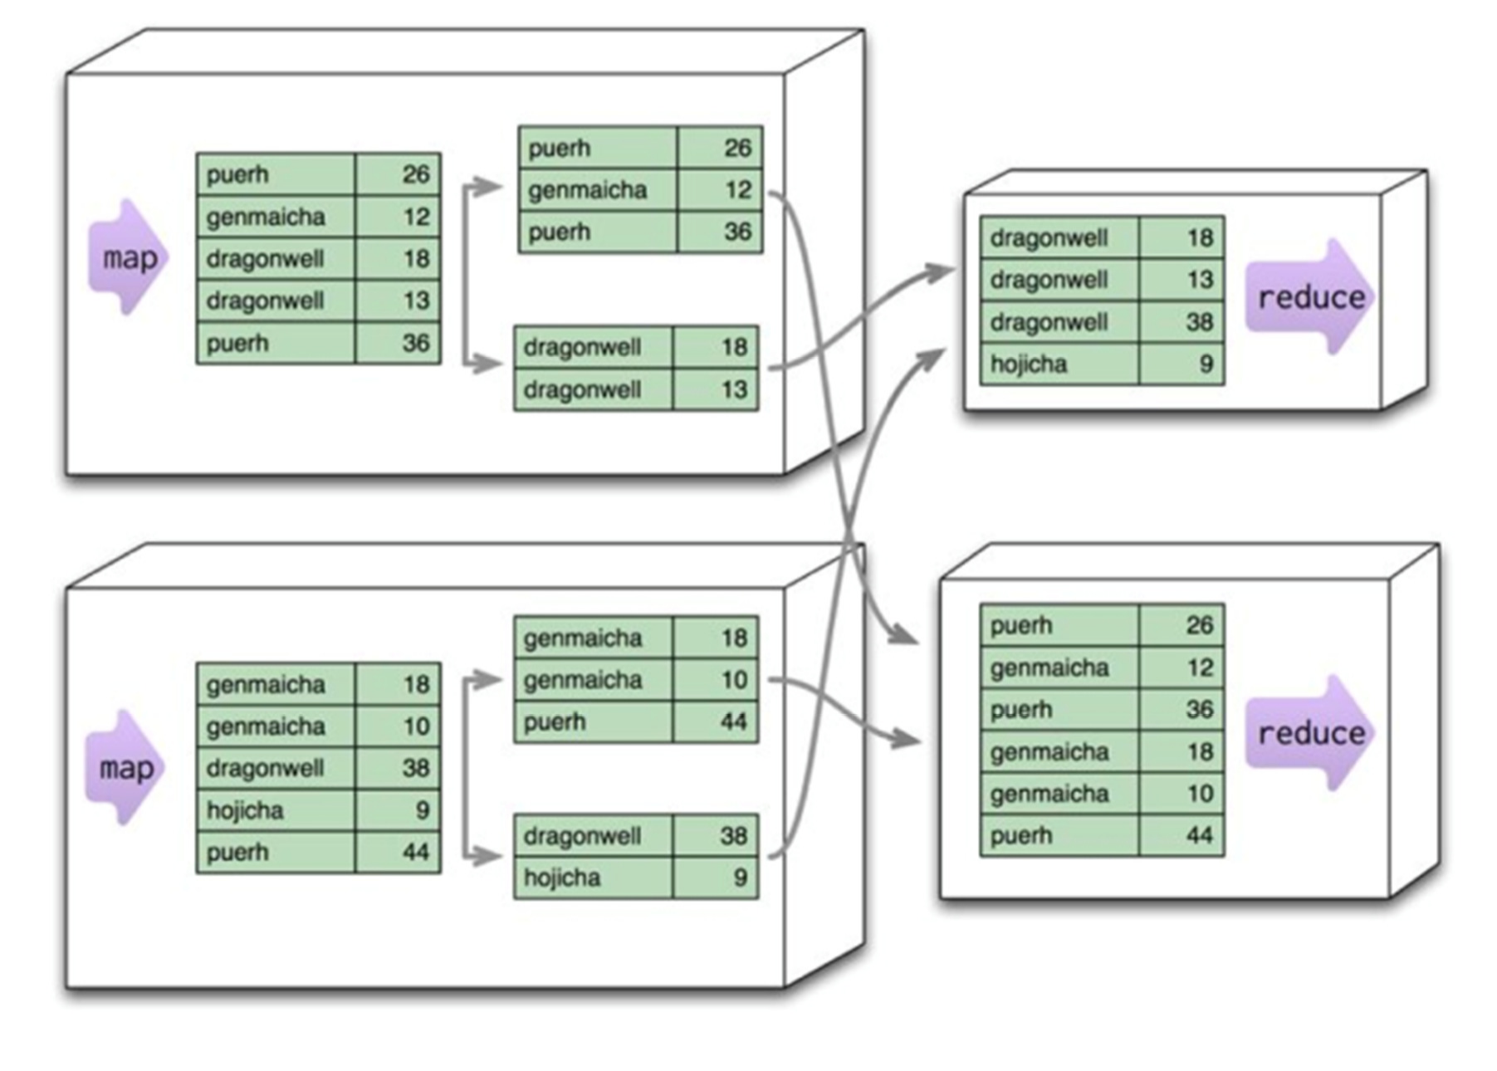
Partitioning map outputs
25

Slide 26
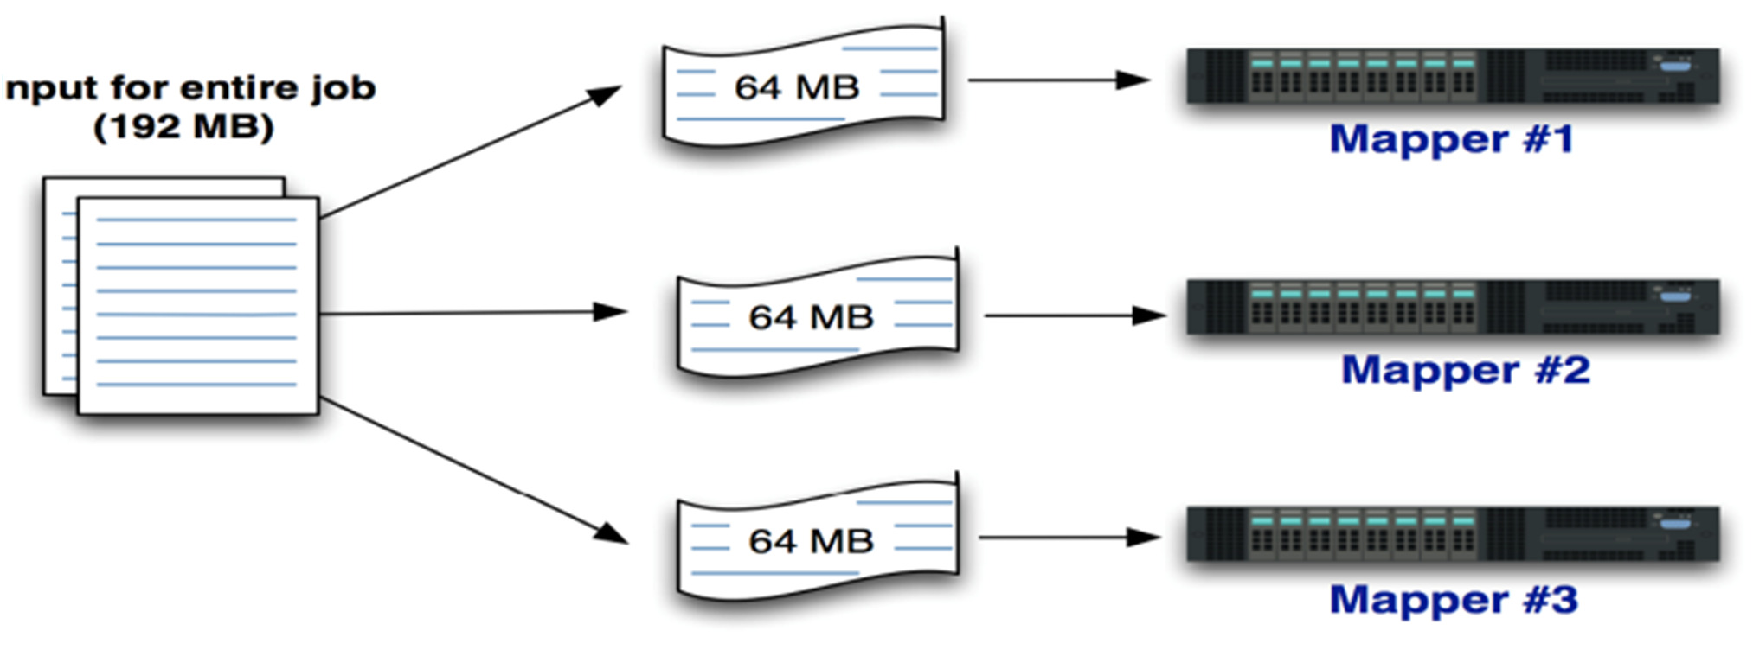
Looking at the entire distributed computation
Coming back to the log example we might have the following situation:
Input for the entire job is subdivided into InputSplits
In Hadoop An InputSplit usually corresponds to a single HDFS (Hadoop Distributed File System) block
Each of these serves as input to a single Map task
26

Slide 27
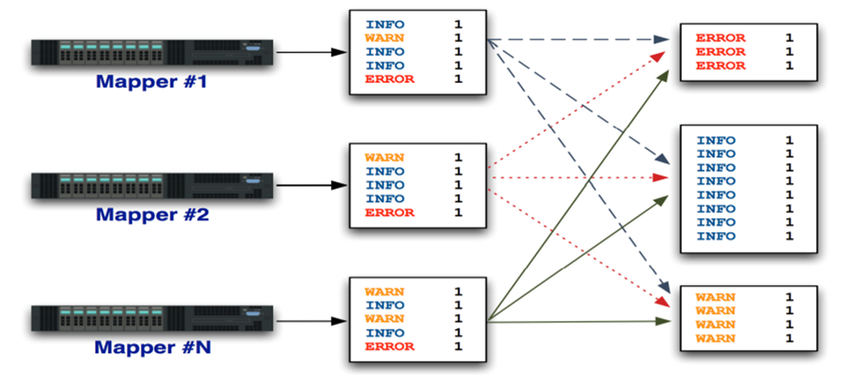
Mappers Feed the Shuffle and Sort
Output of all Mappers is partioned, merged, and sorted (No code required – the framework, e.g., Hadoop does this automatically)
27

Slide 28
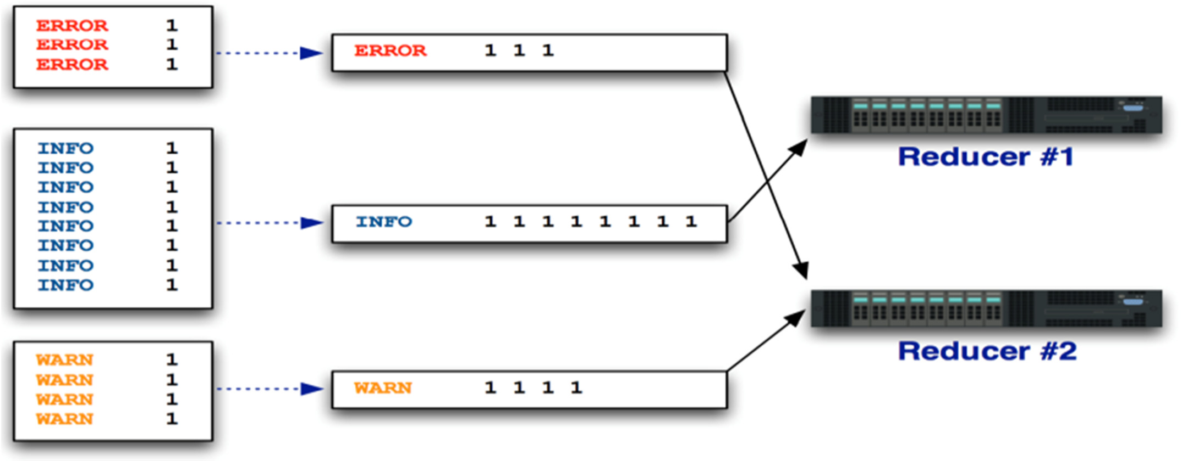
Shuffle and Sort Feeds the Reducers
All values for a given key are then collapsed into a list . The key and all its values are fed to reducers as input
28

Slide 29
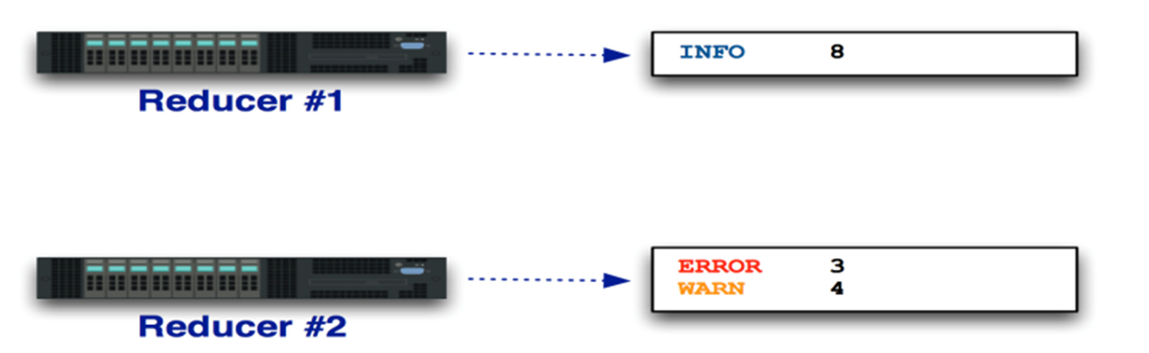
Each Reducer Has an Output
In Hadoop, these are output files stored in HDFS below your output directory. It is then possible to replicate them to a local copy
29

Slide 30
Programming with map-reduce
Map-reduce is powerful, but it has a rigid schema: Within a map task, you can only operate on a single aggregate. Within a reduce task, you can only operate on a single key.
This means you have to think differently about structuring your programs so they work well within these constraints. In particular, you have to structure your calculations around operations that fit in well with the notion of a reduce operation.
Of course, you have to put some care in this
30

Slide 31
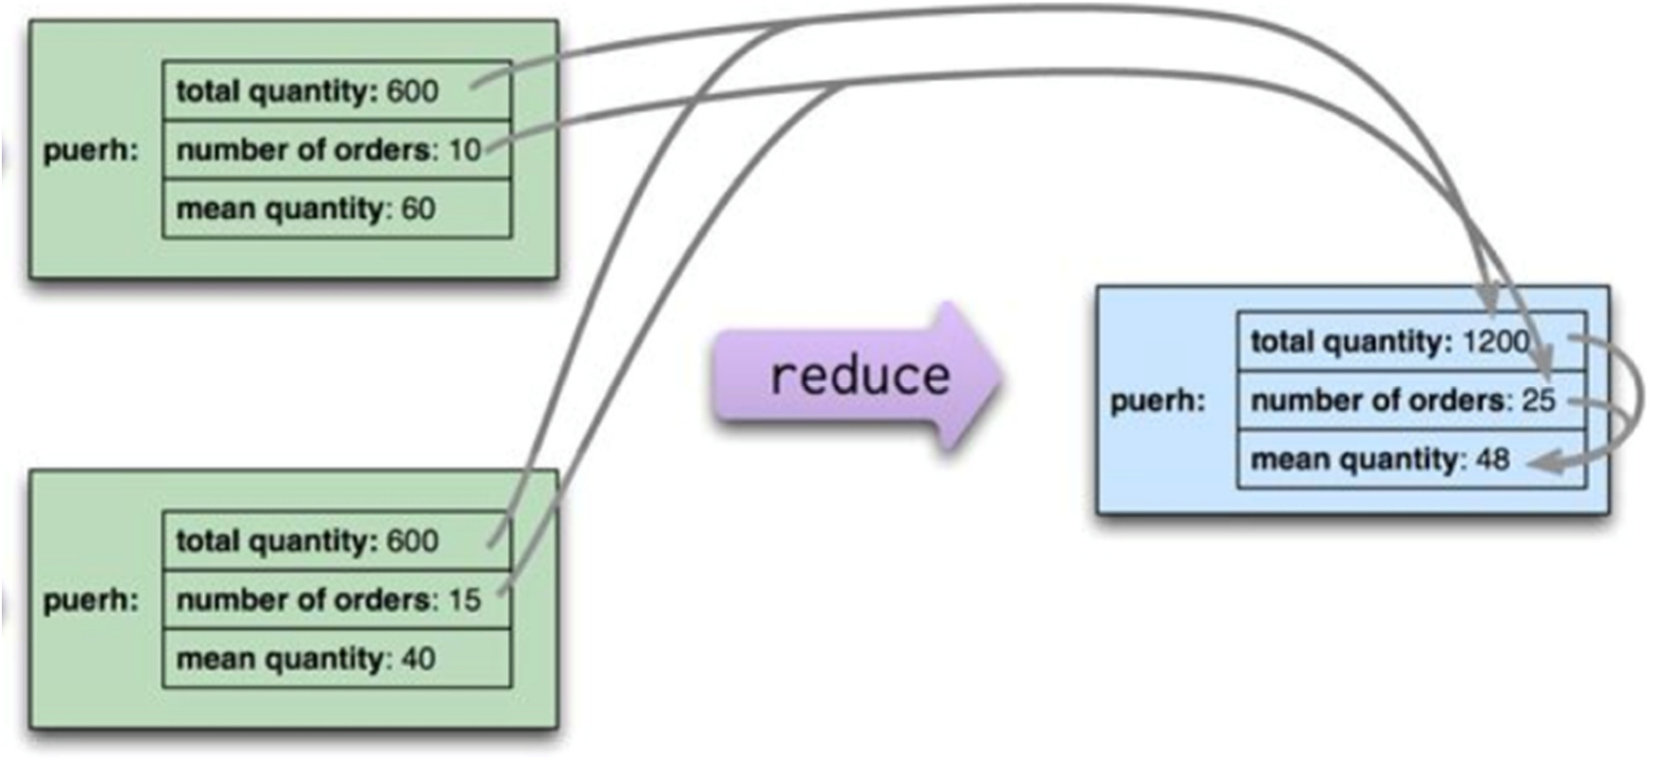
A further example
Let’s consider the kind of orders we’ve been looking at so far; suppose we want to know the average ordered quantity of each product.
But averages are not composable — that is, if I take two groups of orders, I can’t combine their averages alone.
In this case, the reducer needs to take total amount and the count of orders from each group , combine those, and then calculate the average from the combined sum and count
31

Slide 32
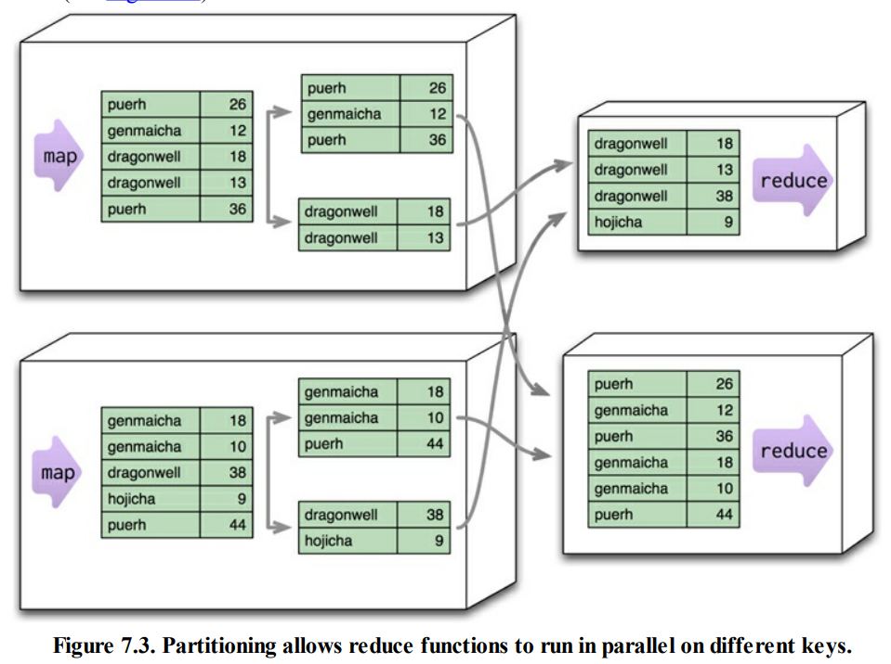
7.2. Partitioning and Combining
Increase the parallelism and to reduce the data transfer as shown in the Figure 7.3:

Slide 33
Increase parallelism by partitioning the output of the mappers.
Each reduce function operates on the results of a single key.
It allows you to run multiple reducers in parallel.
To take advantage of this, the results of the mapper are divided up based the key on each processing node.
Typically, multiple keys are grouped together into partitions.
The framework then takes the data from all the nodes for one partition, combines it into a single group for that partition, and sends it off to a reducer.
Multiple reducers can then operate on the partitions in parallel, with the final results merged together.
This step is also called “shuffling,” and the partitions are sometimes referred to as “buckets” or “regions.”

Slide 34
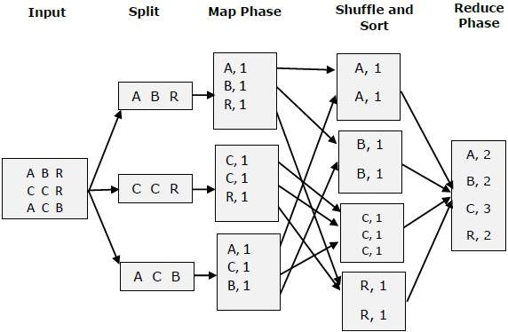

Slide 35
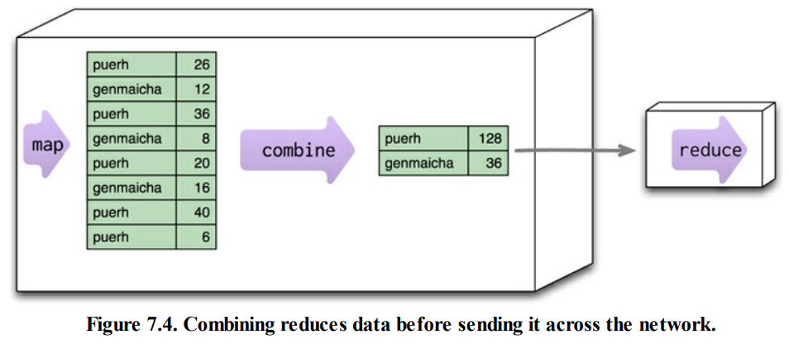
The next problem we can deal with is the amount of data being moved from node to node between the map and reduce stages.
Much of this data is repetitive, consisting of multiple key-value pairs for the same key.
A combiner function cuts this data down by combining all the data for the same key into a single value as shown in Figure 7.4.
Combinable reducer

Slide 36
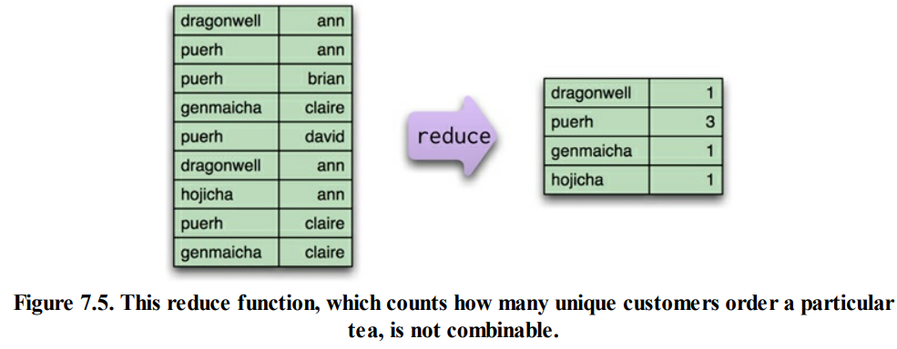
Not all reduce functions are combinable.
Example: Consider a function that counts the number of unique customers for a particular product.
The map function for such an operation would need to emit the product and the customer.
The reducer can then combine them and count how many times each customer appears for a particular product, emitting the product and the count (see Figure 7.5).
But this reducer’s output is different from its input, so it can’t be used as a combiner.

Slide 37
With combining reducers, the map-reduce framework can
safely run in parallel (to reduce different partitions), and
reduce the same partition at different times and places.
In addition to allowing combining to occur on a node before data transmission, you can also start combining before mappers have finished.
This provides a good bit of extra flexibility to the map-reduce processing. Some map-reduce frameworks require all reducers to be combining reducers, which maximizes this flexibility
Example

Slide 38
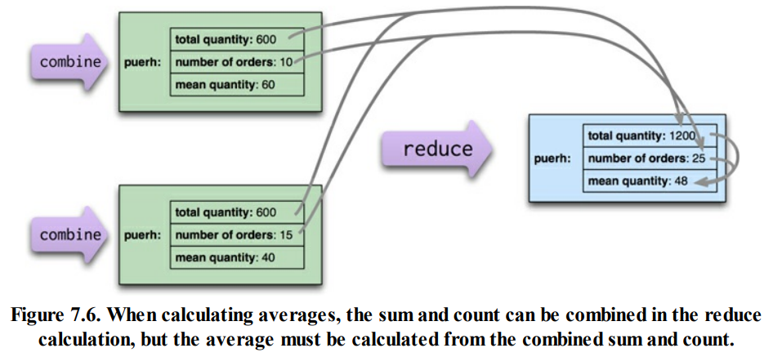
7.3. Composing Map-Reduce Calculations
Example: calculating averages - suppose we want to know the average ordered quantity of each product.
An important property of averages is that they are not composable (see Figure 7.6)

Slide 39
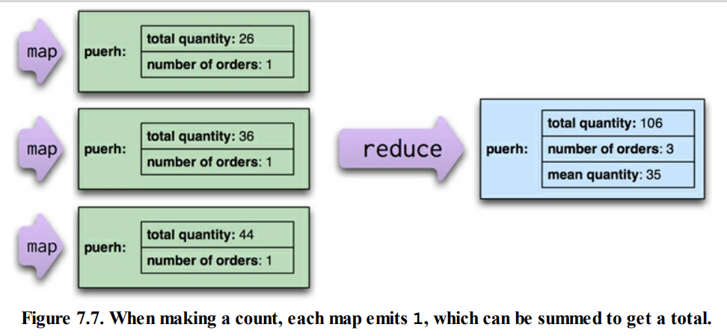
This notion of looking for calculations that reduce neatly also affects how we do counts.
To make a count, the mapping function will emit count fields with a value of 1, which can be summed to get a total count (see Figure 7.7)

Slide 40
7.3.1. A Two Stage Map-Reduce Example
As map-reduce calculations get more complex, it’s useful to break them down into stages using a pipes-and-filters approach, with the output of one stage serving as input to the next.
Example: Compare the sales of products for each month in 2011 to the prior year.
Break the calculations down into two stages:
Produce records showing the aggregate figures for a single product in a single month of the year.
Then uses these as inputs and produces the result for a single product by comparing one month’s results with the same month in the prior year as shown in Figure 7.8 (next slide).

Slide 41
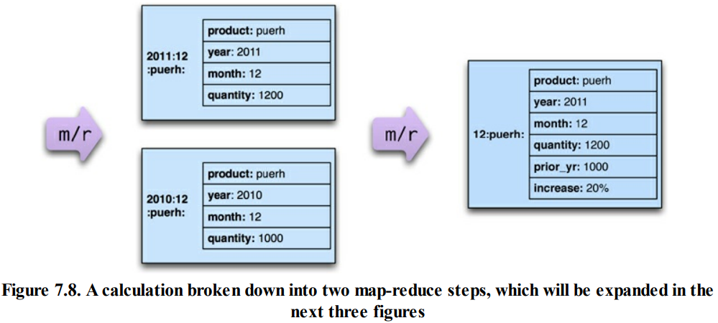

Slide 42
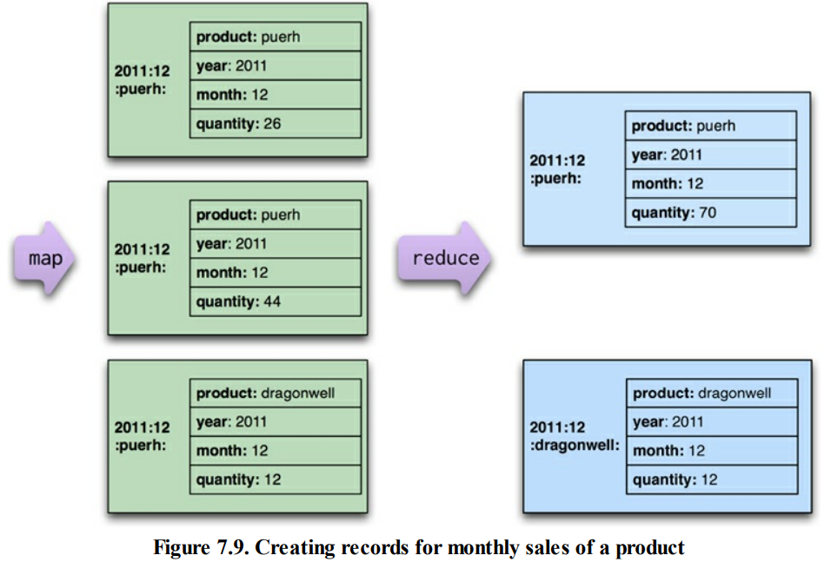
A first stage (Figure 7.9) would read the original order records and output a series of key-value pairs for the sales of each product per month

Slide 43
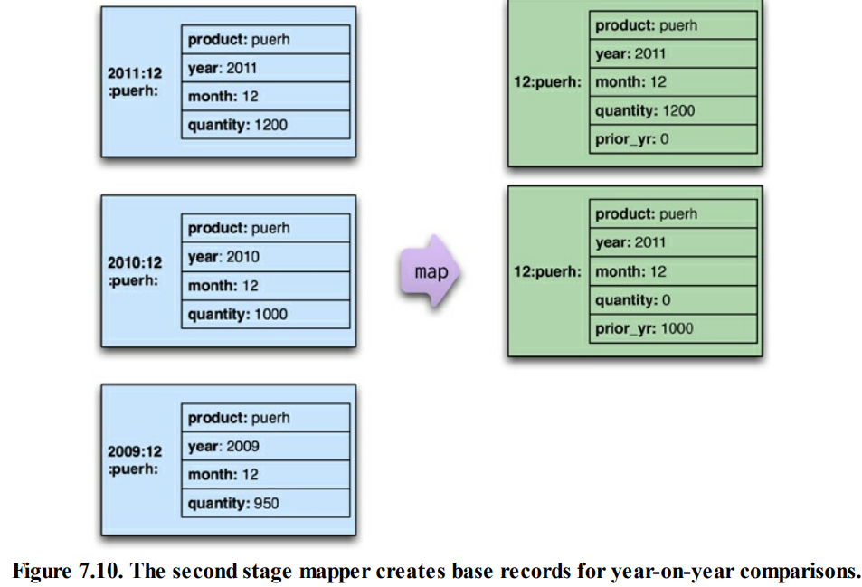
The second-stage mappers (Figure 7.10) process this output depending on the year.
A 2011 record populates the current year quantity while a 2010 record populates a prior year quantity.
Records for earlier years (such as 2009) don’t result in any mapping output being emitted

Slide 44
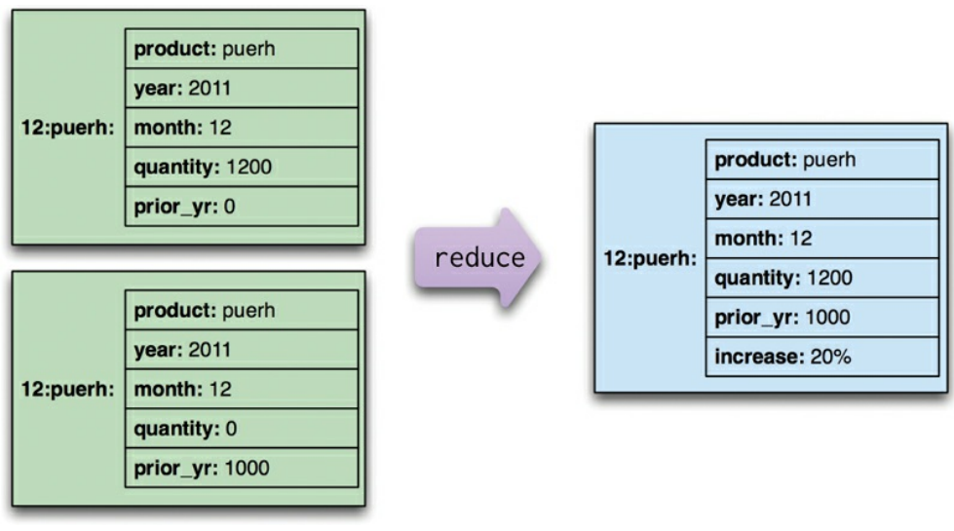
The reduce in this case as shown Figure 7.11 is a merge of records, where combining the values by summing allows two different year outputs to be reduced to a single value (with a calculation based on the reduced values thrown in for good measure).
Figure 7.11. The reduction step is a merge of incomplete records.

Slide 45
7.5. Key Points
• Map-reduce is a pattern to allow computations to be parallelized over a cluster.
• The map task reads data from an aggregate and boils it down to relevant key-value pairs. Maps only read a single record at a time and can thus be parallelized and run on the node that stores the record.
• Reduce tasks take many values for a single key output from map tasks and summarize them into a single output. Each reducer operates on the result of a single key, so it can be parallelized by key.
• Reducers that have the same form for input and output can be combined into pipelines. This improves parallelism and reduces the amount of data to be transferred.
• Map-reduce operations can be composed into pipelines where the output of one reduce is the input to another operation’s map.
• If the result of a map-reduce computation is widely used, it can be stored as a materialized view.
• Materialized views can be updated through incremental map-reduce operations that only compute changes to the view instead of recomputing everything from scratch

